Slide 1
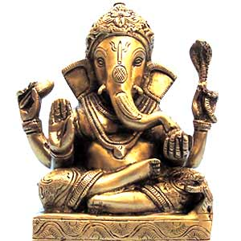
Ganesha
(son of Shiva and Parvati)
The Gods can have children.

Slide 2
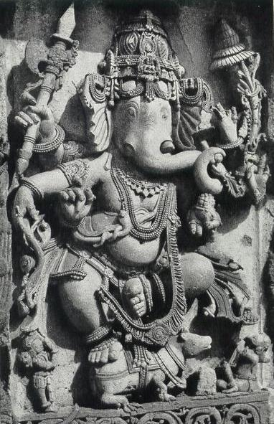
Ganesha
the Lord of success and destroyer of evils and obstacles
worshipped as the god of education, knowledge, wisdom and wealth
one of the five prime Hindu deities

Slide 3
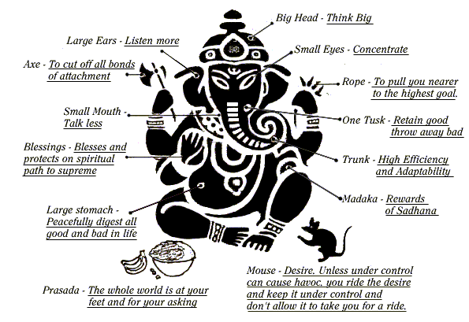
Everything about the Gods is Symbolic

Slide 4
Worship

Slide 5
Hindus worship principally through Darshan, seeing an image of the divinity and receiving its blessing and grace.
Shrines can be anywhere, in great temples, by the road, but especially in the home.
Puja is the act of ritual worship, in which the god is offered fruit, flowers, incense, water, honey or cloth in a special order to symbolize an offering of the self to the god/goddess.
In some cases deities are led in procession through the streets (at festivals, etc.).
Sometimes the worshipper will take a pilgrimage to a sacred place, the most well-known being Benares, on the Ganges River.

Slide 6
A Hindu Priest performing a puja to the Goddess Kali.

Slide 7
The two main areas where puja is offered is in the temple or in the home. The home is the main centre of worship.

Slide 8
Most Hindu homes have a puja room, or at least a corner of the home where they can do a daily puja.

Slide 9
Kali temple Kolkata, India

Slide 10
Hindu temple interior, Singapore

Slide 11
Ancient Shiva temple at Rameswaram,inside walkway

Slide 12
Hindu temple, Toronto

