Slide 1
Key Terms
Avatar
Brahma
Vishnu Saraswati Vaishnavism Rama Krishna
Shiva Lord Nataraj Parvati Kali Durga Shaivism Dissolution
Devi Shaktism
Ganesha
Consort
Trimurti
Brahman Atman Jiva Om
Moksha
Maya Samsara
Kundalini
Chakras
Darshan
Puja

Slide 2
Gods and Goddesses and Avatars of Hinduism

Slide 3
There can really be as many Hindu Gods as there are devotees to suit the moods, feelings, emotions & social background of the devotees."
-Sri RamaKrishna
Countless Gods

Slide 4
Brahman
Brahman refers to the Absolute Reality in Hinduism.
All other deities are personifications of aspects of Brahman.
Brahman is eternal without beginning or end, transcendent, unchanging, omnipresent, omniscient, omnipotent, and without attributes

Slide 5
Brahman
Take a glass of water. Add some sugar – it will dissolve into the water and you won’t be able to see it or remove it. Now taste the water and you will taste the sugar in every drop of the water.
In this analogy the water represents the world and the sugar represents Brahman, though invisible Brahman is omnipresent (everywhere.)

Slide 6
Brahman
Brahman is the highest conception of God in Hinduism
Brahman is transcendent (beyond time and space, beyond words), but can roughly be described as ‘Satchitananda’ - sat: (being): chit ( awareness): ananda (bliss)
Brahman can have no form (above) – this Nirguna Brahman
Or Brahman can take a form (as a God or Avatar); this is Saguna Brahman: the noblest reality encountered in the world.

Slide 7
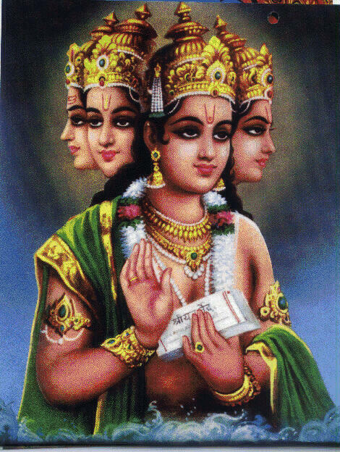
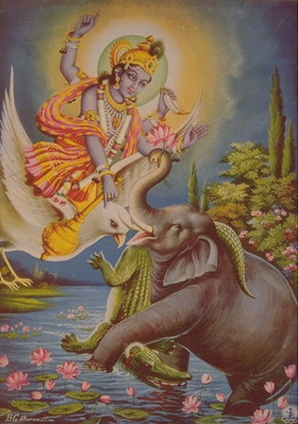
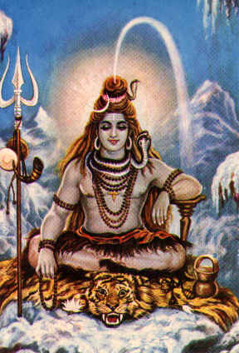
The many gods of Hinduism represent different aspects of one and the same ultimate reality, Brahman.
Brahma
Vishnu
Shiva
Hinduism views the cosmic activity of the Supreme Being as comprised of three tasks: creation, preservation, and dissolution and then recreation. Three deities (Trimurti) represent these tasks: Brahma, Vishnu, and Shiva.
Notes:
Trimurti systematized in the Puranas composed during the Gupta Period: 320-540 CE.

Slide 8
Atman
Atman is the term used in Hinduism to describe Brahman within a person.
Before enlightenment the Atman is known as the ‘jiva’.
The Atman is indestructible and after the death of the body it either achieves Moksha or is reborn into another body. Rebirth is determined by the law of samsara and karma.

Slide 9
Trimurti
The three main Gods in Hinduism are Brahma, Vishnu and Shiva
They are actually the same reality (Brahman), but represent separate aspects of Brahman, and have separate ‘personalities’ in the scriptures and to their respective devotees
The are commonly called the Creator (Brahma), the Preserver (Vishnu), and the Destroyer (Shiva)
Mnemonic: G.O.D. = Generator, Operator, Destroyer
Each God of the Hindu pantheon has a Goddess as His partner who is His equal in every respect
Each God has a animal `vehicle`
Each God or Goddess can and does take birth as a ‘human’
These beings are called ‘Avatars’

Slide 10
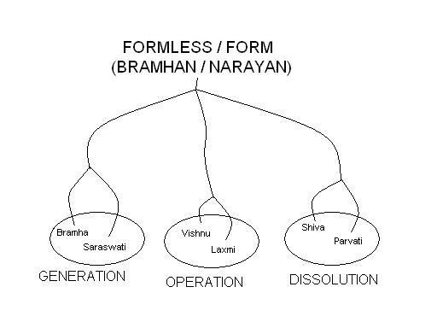
In Hinduism all Gods and Goddesses (and Avatars) are
Manifestations of the formless Brahman
Om is a word, designating a cosmic sound or vibration that is all pervading.
It is the most common name of God.
It is the same as Brahman.
Notes:
Saadhakaanam hitarthaaya, Brahmano rupakalpana.
Bramhan, the formless, is assigned forms to ease the aspirant’s understanding of Vedic principles. Bramhan is derived from Brahat, meaning the largest thing conceivable by man
Bramha-Saraswati represent Generation principles. Creation requires correct knowledge.
Vishnu-Laxmi represent Operation principles. Preservation requires sustenance.
Shiva-Parvati represent Dissolution principles. Constructive-destruction requires tremendous energy.

Slide 11
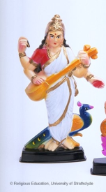
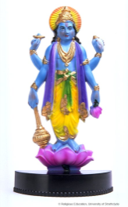
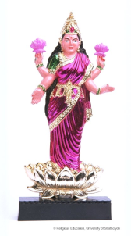
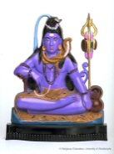
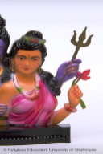
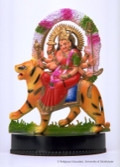
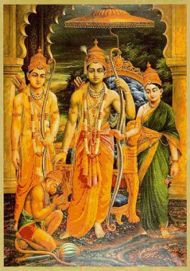
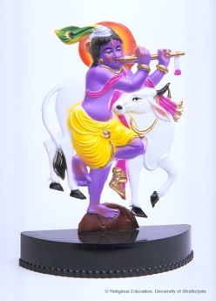

Main Hindu deities
BRAHMAN
(suptreme spirit)
BRAHMA SARASWATI
(creator (creativity)
VISHNU LAKSHMI
(preserver) (good luck & wealth)
SHIVA PARVATI
(destroyer) (mother figure
MAHA YOGI
NATARAJ
(Lord of the dance)
DURGA
(war)
AVATARS
Son of Shiva & Parvati
RAMA
KRISHNA
GANESH (good luck)
10 incarnations of Lord Vishnu in human or animal form including Buddha and Kalki (still to come)
LINGUM
(fertility symbol)
KALI
(death)

Slide 12
There are three major devotional traditions:
  Vaishnavism (worship of Vishnu)
    Generally vegetarian
    Worship Vishnu or his avatars Rama and Krishna.
    Oriented towards duty and tradition.
  Shaivism (worship of Shiva)
    Worship focuses on union of opposites, especially creation and destruction.
    Tend to emphasize ascetic practices.
  Shaktism (worship of the Goddess (or ‘Devi’)
    Worship “the goddess” as ultimate reality.
    Not as likely to be vegetarian.

Slide 13
Note: although Brahma is called the `creator`, at times creation can be ascribed to the other gods and goddesses
(e.g. Shiva or Devi, the goddess)

Slide 14
Images of Hindu Gods and Goddesses

Slide 15
Everything about the depiction of Hindu Gods and Goddesses has a symbolic meaning.

Slide 16
Everything about the depiction of Hindu Gods and Goddesses can be taken either literally or symbolically and philosophically, depending on the level of the believer’s understanding.

Slide 17
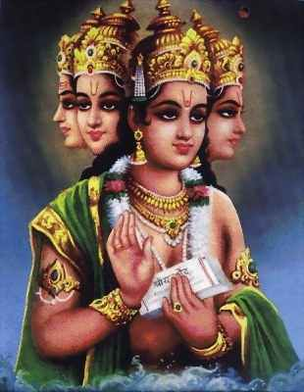
Brahma
It is often said that the Hindu pantheon has three gods at its head: Brahma, the creator of the universe; Vishnu, the preserver of life; and Shiva, the destroyer of ignorance.
Brahma is a representation of the impersonal brahman in a human form, usually with four faces facing the cardinal directions and four arms

Slide 18
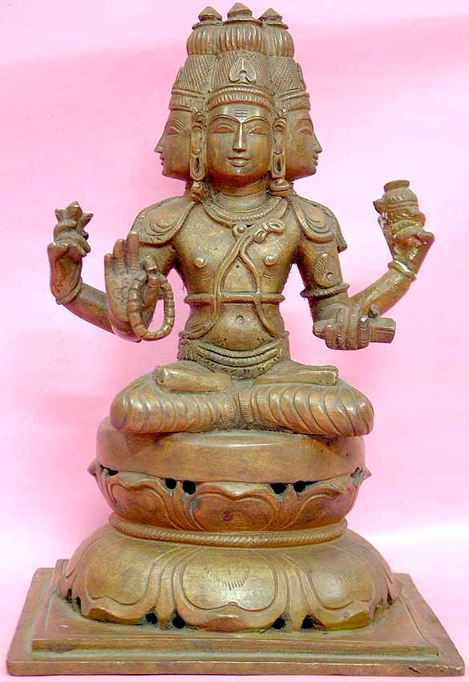
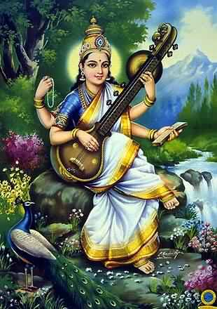
Brahma (Creator) and Saraswati, his Consort/wife.
Saraswati is the goddess of knowledge and speech. Her ‘Vehicle’ is the swan.

Slide 19
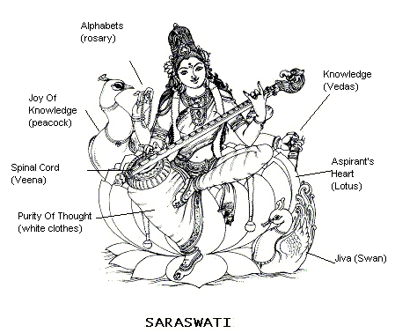
Goddess Saraswati symbolizes Divine Knowledge
Saraswati means ’the one who gives the knowledge of one’s own Self and Universe.’
Notes:
Saraswati means the one who gives the essence (Sara) of one’s own Self (Swa).
Lotus seat denotes the aspirant’s heart.
The four hands signify Her divinity. Right hand has the rosary (akshamala) - the alphabets of a language (Sanskrit).
The musical instrument (Veena) embodies the spinal cord important in physical, emotional and spiritual aspects of life.
The book (Vedas) in Her left hand denotes knowledge.
The swan (soul) as Her vehicle symbolizes the devotee’s ability to absorb the good and reject evil. (Mythologically, the swan can separate milk mixed in water).
The peacock signifies the joy of knowledge.
Her white clothes indicate the purity of thought in pursuit of knowledge.

Slide 20
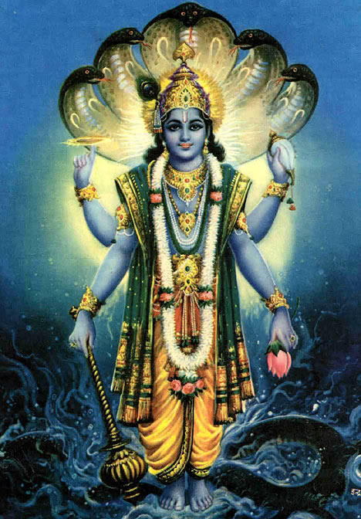
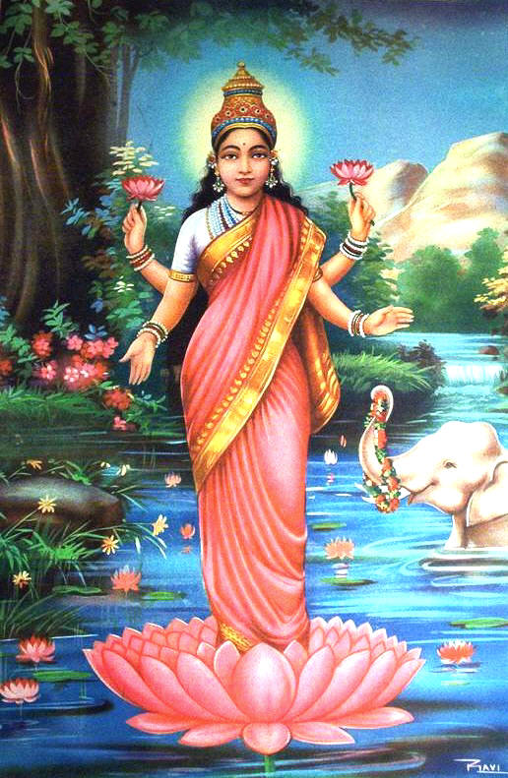
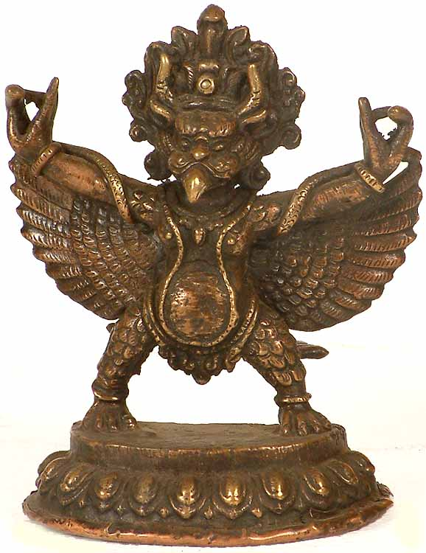
Vishnu (maintainer of the universe)
  Consort: Lakshmi (good fortune and prosperity)
  Vehicle: “Garuda”—eagle/human hybrid

Slide 21
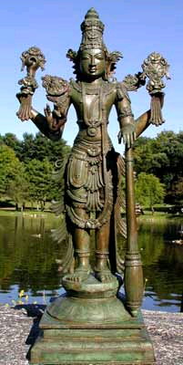
Vishnu preserves the working order of the universe
Lord Vishnu the Preserver
"Only the unlearned deem myself (Vishnu) and Shiva to be distinct; he ,I, and Brahma are one, assuming different names for the creation, reservation and destruction of the universe. We, as the triune Self, pervade all creatures; the wise therefore regard all others as themselves."
~ Vishnu explains the Nature of the Trinity (trimurti)~

Slide 22
Avatars
In addition to the existence of Gods and Goddess Hinduism believes in the existence of ‘Avatars’
An ‘avatar’ is the descent of Brahman to earth in a human body.

Slide 23
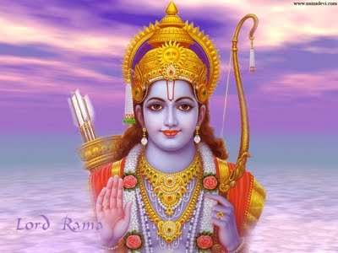
Many Avatars
There are many avatars in Hinduism. Two of the best known are Rama and Krishna, who were avatars of Vishnu (i.e. Vishnu in human form)

Slide 24
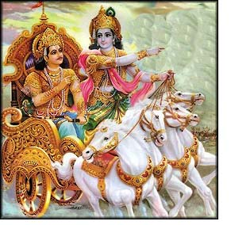
Vishnu appears in many avatars (traditionally ten, the last, who has not yet appeared, is Kalki, who will come when he is most needed).
The two most important avatars of Vishnu are Rama and Krishna.
Krishna (right) and Arjuna, his disciple, devotee and friend (left). Gods are traditionally depicted as blue.

Slide 25
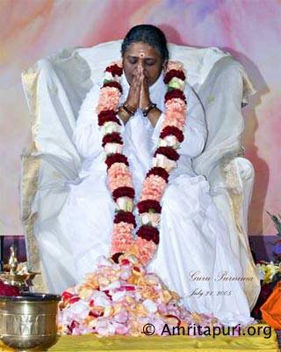
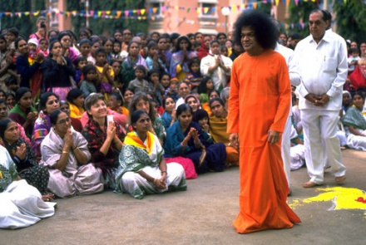
There are still Avatars today
Mata Amritaranadamayi
(1953- present)
Satya Sai Baba (1926-2011)

Slide 26
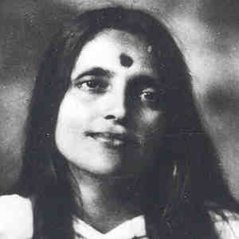
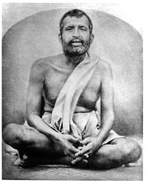
More recent Avatars
Anandamayi Ma
(1896-1982)
Ramakrishna Paramahamsa (1836-1886)

Slide 27
The function of the Avatar is to uphold dharma and guide humanity to God.
They have miraculous powers but are very cautious about showing them. Satya Sai Baba was the exception.
They have hundreds of millions of follows today.

Slide 28
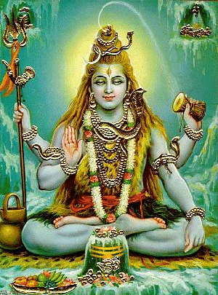
Shiva
The “Great God” of yogis and yogic practice
Often represented as “King of Dance”
Often represented in meditation in the Himalayas

Slide 29
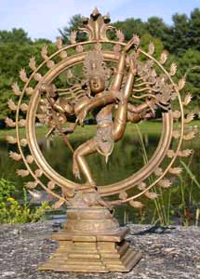
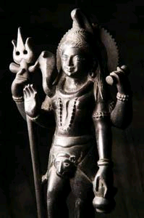
Shiva
Shiva destroys the world at the end of time. He also destroys ignorance by granting enlightenment.
Lord Shiva the Destroyer

Slide 30
Shiva destroys the world at the end of time. (It returns to an unmanifest form).
The image of Shiva as the Cosmic Dancer is very philosophically complex.
In part, it is seen as the image of Shiva’s rhythmic play which is the source of all movement within the universe. This is represented by the circular or elliptical frame surrounding the Lord.
Secondly, the purpose of his dance/play is to release the souls of all men from the snare of `maya` or cosmic illusion .

Slide 31
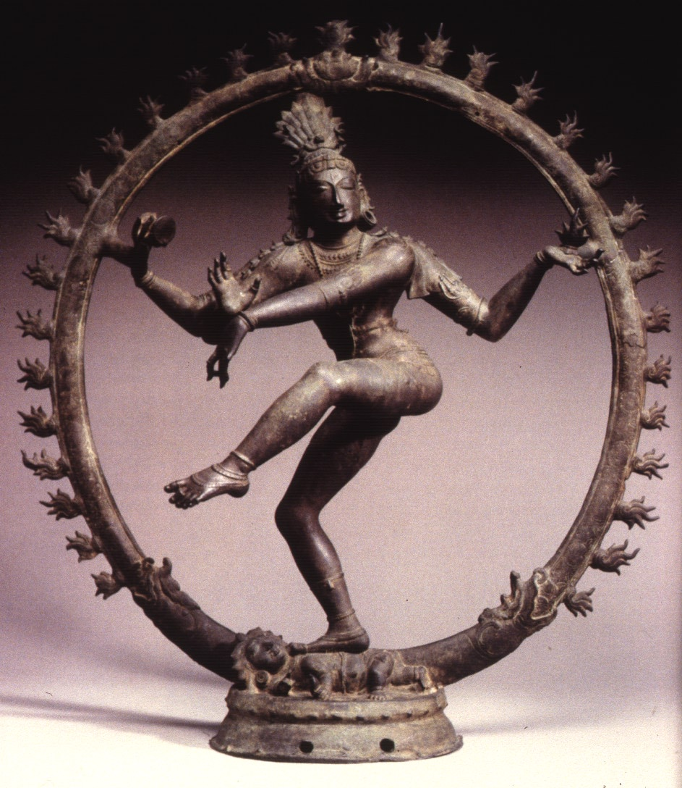
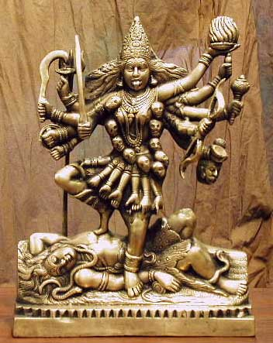
Shiva (in the guise of the destroyer) has Kali as his consort. Kali destroys ‘demons’, i.e. the (selfish) human ego and its negativities. This causes enlightenment.
Shiva – the Cosmic Dancer
Kali

Slide 32
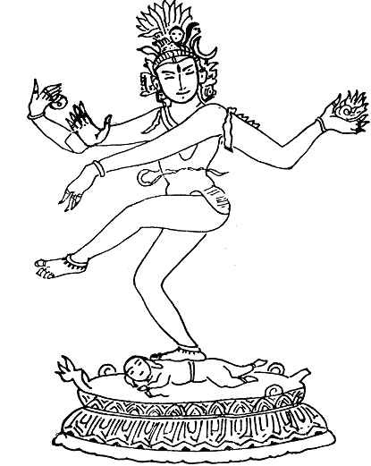
Shiva as Lord Nataraja, the Divine Dancer, in Spiritual Bliss.
Dwarf - demon of forgetfulness
Snake - Kundalini yogic energy
Drum - prana energy
Fire - apana energy
Two hands in the middle - blessing of fearlessness
Head Ornaments - Sun, moon and fire
Notes:
The world and heart of a devotee are a stage. Divine dance represents the vision of life and activity through the dance of the all pervading God.
The drum and the fire in His right and left hands signify the vital forces - prana and apana. The union of prana and apana is one of the goals of yoga.
The snake signifies the yogic energy as Kundalini.
The blessing of fearlessness to a devotee is indicated by His two hands in the middle.
The dwarf-demon being crushed is Apasmara represents forgetfulness of one’s innate divinity.
This ignorance makes humans not conscious of the indwelling divinity, their actions causing misery and suffering. The darkness Apasmara is dispelled by the Cosmic divine dance of Lord Nataraja, which brings spiritual enlightenment.

Slide 33
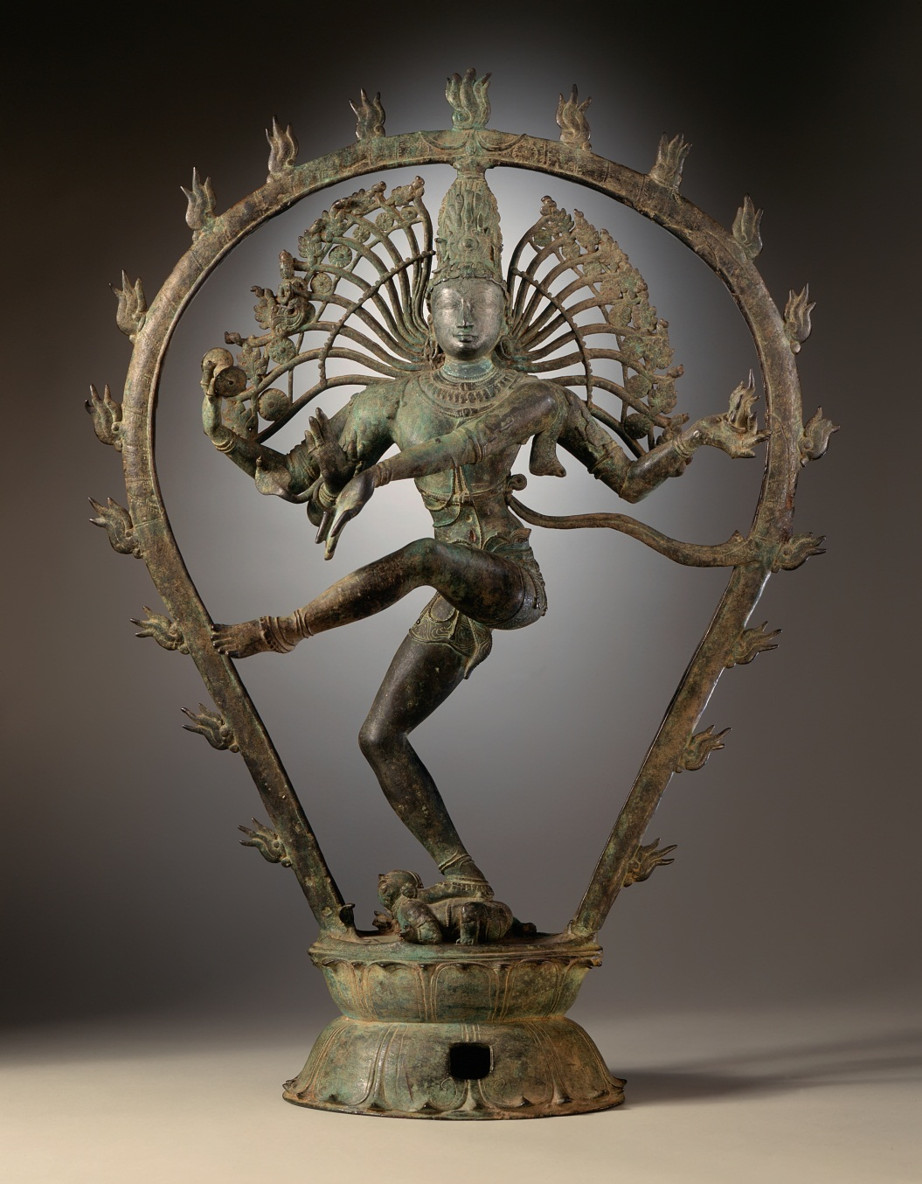
Shiva Nataraja, the Lord of the Dance.
The third eye on the forehead of the Lord is a symbol of his omniscience. The cobra wrapped around his neck represents the Kundalini, a divine energy present, but asleep, in every living being at the base of the spinal cord. Through spritual practices the sleeping kundalini awakens, and as it moves up the spine, it awakens spiritual centres along the spine, bringing various spiritual experiences and powers. When it reaches the top of the head, one achieves enlightenment..

Slide 34
THE SIGNIFICANCE OF SHIVA’S DANCE
First, it is an image of his rhythmic play which is the source of all movement within the universe. This is represented by the circular or elliptical frame surrounding the Lord.
Secondly, the purpose of his dance is to release the souls of all men from the snare of illusion.
Lastly, the place of the dance is actually within the heart.
Nataraj is a visual interpretation of Brahman. It is the representation of reality at the time of cosmic destruction. We being life forms, cosmic destruction would mean the disappearance of all life. The half moon shown in the head of Nataraj is a symbol only. The fall of the moon would result in cosmic destruction.

Slide 35
Kundalini – the Goddess within

Slide 36
Kundalini
We all have a divine energy within us called the Kundalini. The Kundalini, usually referred to either as a goddess or a serpent which ìs inactive in most people until awakened through spiritual practices.

Slide 37
Kundalini `sleeps`at the base of the spine. But when awakened, she rises through the `chakras`, energy centres in the spinal cord up to the brain bringing about enlightenment..

Slide 38
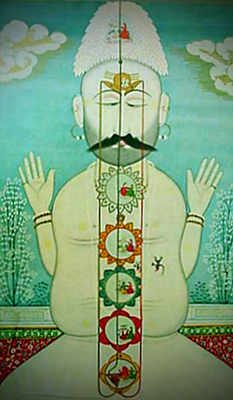
Chakras
There are seven chakras along the spine. When these energy centres are awakened the spiritual practitioner achieves various psychic powers.
Traditional Indian painting

Slide 39
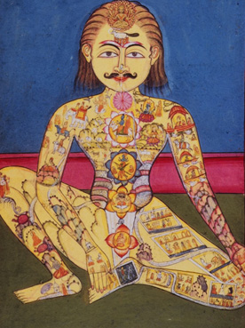
Chakras are energy centres in the body that the awakened kundalini energy rises through.

Slide 40
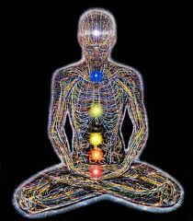
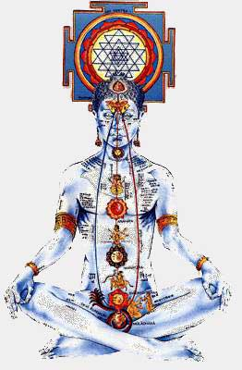
Contemporary Paintings of the Chakra system

Slide 41
Chakras
Chakras are energy centres located along the spine through which the awakened kundalini energy rises.
There are seven chakras, each, when awakened, confers special powers on the yogi.

Slide 42
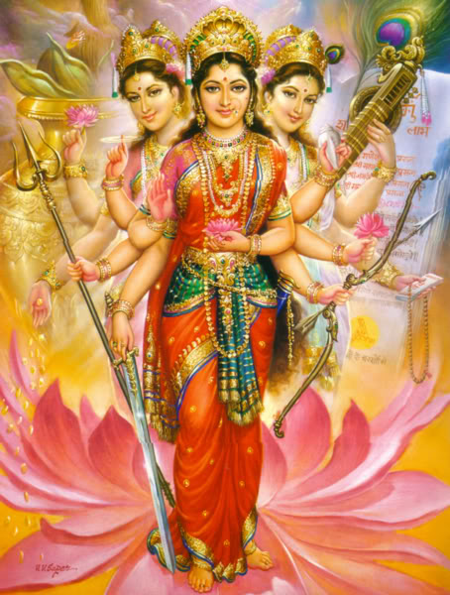
Devi (the goddess) is sometimes worshipped as the supreme manifestation of Brahman. All other gods and goddesses would then be considered emanations of her.
Devi is the sanskrit word for Goddess. She is the female counterpart of each God without whom the , which represents consciousness or discrimination, remains impotent and void. Goddess worship is an integral part of Hinduism. Devi is, quintessentially, the core form of every other Hindu Goddess.
Devi or the divine feminine is an equal conterpart to the divine masculine. She, manifests herself as her own Trinity.
Saraswati + Brahma
Lahksmi + Vishnu
Parvati + Shiva
Each of these forms has many other forms.

Slide 43
Feminine Theology -
A Gift of Hindus to the World
Hinduism is the ONLY major religion that worships God also as a woman. All other major faiths see God as a ‘Fatherly’ figure only.
Even in Male oriented Hindud traditions, Devi plays an important role.
In Hindu Dharma, Wisdom/Knowledge, Prosperity, Power etc., represented symbolically by feminine Hindu deities

Slide 44
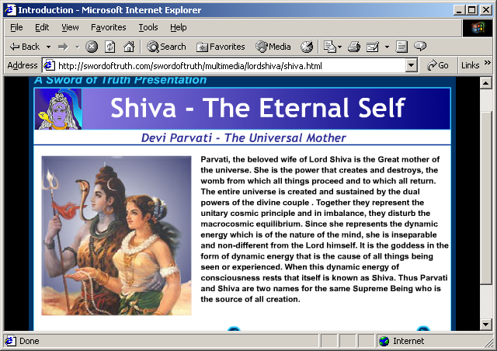
Parvati, consort and equal of Shiva

Slide 45
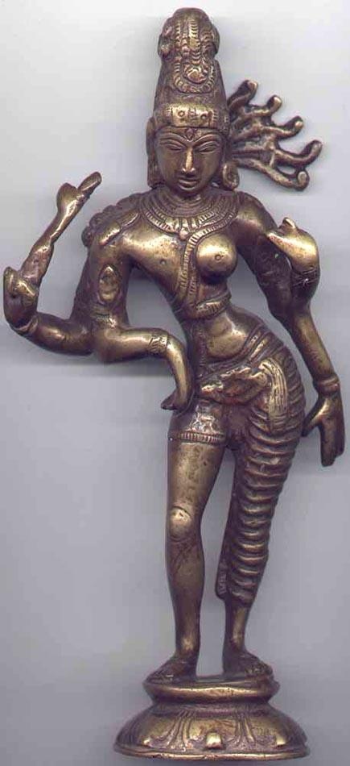
Ardhanaariishvara
Shiva as Half-Woman
Since ‘God’ is actually Brahman, he is neither male or female. Hindus represent this in many ways.
In the Shaiva tradition, God often represented as a half woman
In the Vaishnava tradition, Vishnu often incarnates as a woman to preserve and protect Dharma (Mohini avatar)
When God is worshipped as ‘parent’, ‘mother’ takes precedence over ‘father’ aspect.
Both Women and Men are manifestations of God (contrast: According to the Abrahamic faiths, man was created in the image of God, and women from that man’s extra rib!)
Notes:
The Shaiva tradition is considered the ‘male’ counterpart of the Shaakta tradition and the two share numerous texts, liturgies and other sacred traditions. In numerous iconic representations, God is shown as ‘ardhanariishvara’ or ‘God who is half woman’, to emphasize that either God has no gender or he is both woman and man.
Even male deities such as Lord Vishnu sometimes incarnate as women ('Mohini') to serve the cause of Dharma. The Devi herself is often said to combine the powers of all male deities including Brahma, Vishnu and Shiva.
‘tvam strii tvam pumaanasi’ -‘Thou art the woman and the man’ (Atharvaveda Saunaka Samhita 10.8.27); ‘strii pumsau Brahmano jatau striyah brahma uta vavana’ – ‘Women and Men are both born from Supreme Being, Women are (manifestations) of the Supreme Being and so are these men’ (Atharvaveda Paippalada Samhita 8.9.11cd)
In popular non-denominational Hindu prayers, whenever God is addressed as a parent, he is first termed as a Mother, and only then as a Father. The prayer commencing with the words ‘tvameva mata cha pita tvameva’ (You alone are Mother, and are also our Father) is recited by millions of Hindus all over the word.
It is a Hindu tradition to address women before men in a group, out of reverence for the former. For instance, Hindu wedding invitations are normally addressed ‘To Mrs. and Mr. Smith’ and so on and not as ‘To Mr. And Mrs. Smith’ or as ‘ To Mr. and Mrs. John Smith’ or even as ‘To Mrs. and Mr. John Smith’.

Slide 46
Durga another `demon`slaying form of Devi
Notes:
A major Hindu festival, the Durga Puja during Navaratri, worships God as the Divine Mother in her various forms such as Durga.
In this tradition, the Divine Mother is termed as ‘Shakti’ or ‘The (Supreme) Power’, as ‘Uma’ or the Sacred Wisdom, as ‘Mahesvari’ or ‘The Supreme Goddess’ and so on. The Shaakta tradition has hundreds of texts (often termed generically as ‘Tantras’) and traditions considered authoritative by Hindus even outside that specific tradition. Even texts not specifically belonging to the Shaakta tradition per se have sections that eulogize the Divine Mother. For instance, the famous ‘Devi Mahaatmya’ (the glory of Devi’) occurs in the Markandeya Purana which is not a Shaakta text.
Popular Hinduism also exhibits the concept of ‘grama-devata’ in which a local manifestation of the Divine is worshipped as the presiding deity of that place. Many Indian cities and towns, including several important pilgrim centers, have various forms of the Divine Mother as their ‘grama-devi’. As examples, we may cite Amba who is worshipped in Kolhapur and Ahmadabad (formerly called Ambavad); Meenakshi who is worshipped in the pilgrim town of Madurai; a form of Sati, the wife of Shiva, worshipped in Jalandhar; and Dhakeshvari Devi of Dhaka (capital of Bangladesh).

Slide 47
Shakti, the Powerful Devi, Killer of Mahishaasura
Notes:
Significantly, the Shaakta tradition specifically worships the Divine as the Mother of the Universe (Markandeya Purana 91.2), to whom all the male deities also bow in reverence. Shrines of this tradition have perhaps a greater geographical spread than those of other traditions in the Indian subcontinent. The 52 main shrines are termed as ‘shaktipeeths’. They are spread all over Pakistan, India, Bangladesh and Nepal. Even Afghanistan has several Devi shrines that have now almost been abandoned because the Hindu minority has been oppressed by Islamists.

