Slide 1
The Sonnet
One of the most celebrated forms of poetry

Slide 2
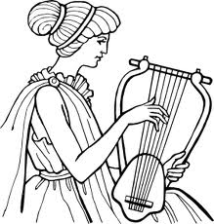
What is a Sonnet?
‘sonetto’ – little sound or song
Type of Lyrical Poetry
To be played with a lyre
Expresses intense personal feelings and emotions
14 lines
Strict rhyming scheme
Thematic Structure

Slide 3
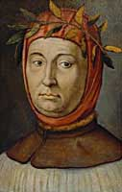
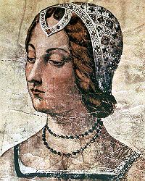
The Italian Sonnet
First 8 lines – Octave
abbaabba
Volta
Change from one rhyme group to another
Last 6 lines – Sestet
3 rhyming sounds
cdecde
Variations - cannot end in couplet
Francesco Petrarch’s Canzoniere

Slide 4
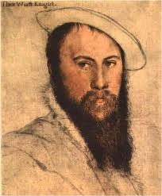
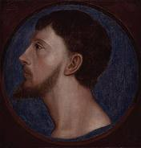
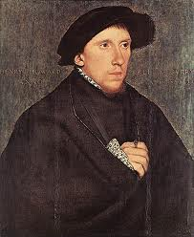
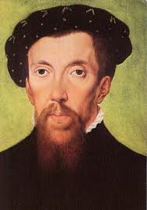
The English Sonnet
Sir Thomas Wyatt
Ended with couplet
Earl of Surrey – Henry Howard
Introduces different rhyming meter
3 quatrains and a couplet
Placement of volta at the third quatrain

Slide 5
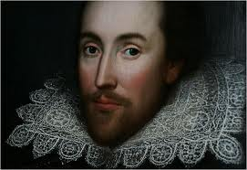
The Shakespearean Sonnet
Elizabethan Sonnet
3 quatrains and a couplet
Variation in the placement of volta
Iambic Pentameter
Used in his plays
154 Sonnets
composed 1592-98 (1609)
1 – 126 – young man to marry before youth ends
127 – 154 – ‘The Dark Lady’

Slide 6
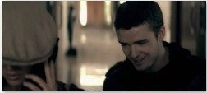
Sonnets Today...
Not as popular as it once was
Free verse
Themes still prevalent
Sharing intense emotions and experiences from a distance

Slide 7
DIG IN AND ENJOY SOME SONNETS!
Shakespeare Sonnets
Sonnet 5
Sonnet 18
Sonnet 116
John Donne
Holy Sonnet XIII
Elizabeth Barrett Browning
Sonnet 9

Slide 8
Sonnet 5
Those hours, that with gentle work did frame The lovely gaze where every eye doth dwell, Will play the tyrants to the very same And that unfair which fairly doth excel; For never-resting time leads summer on To hideous winter, and confounds him there; Sap checked with frost, and lusty leaves quite gone, Beauty o'er-snowed and bareness every where: Then were not summer's distillation left, A liquid prisoner pent in walls of glass, Beauty's effect with beauty were bereft, Nor it, nor no remembrance what it was: But flowers distill'd, though they with winter meet, Leese but their show; their substance still lives sweet.

Slide 9
Sonnet 18
Shall I compare thee to a summer's day? Thou art more lovely and more temperate: Rough winds do shake the darling buds of May, And summer's lease hath all too short a date: Sometime too hot the eye of heaven shines, And often is his gold complexion dimm'd; And every fair from fair sometime declines, By chance or nature's changing course untrimm'd; But thy eternal summer shall not fade Nor lose possession of that fair thou owest; Nor shall Death brag thou wander'st in his shade, When in eternal lines to time thou growest: So long as men can breathe or eyes can see, So long lives this and this gives life to thee.

Slide 10
Sonnet 116
Let me not to the marriage of true minds Admit impediments. Love is not love Which alters when it alteration finds, Or bends with the remover to remove: O, no! it is an ever-fixed mark, That looks on tempests and is never shaken; It is the star to every wandering bark, Whose worth's unknown, although his height be taken. Love's not Time's fool, though rosy lips and cheeks Within his bending sickle's compass come; Love alters not with his brief hours and weeks, But bears it out even to the edge of doom. If this be error and upon me proved, I never writ, nor no man ever loved.

Slide 11
Holy Sonnet XIII
What if this present were the world's last night ? Mark in my heart, O soul, where thou dost dwell, The picture of Christ crucified, and tell Whether His countenance can thee affright. Tears in His eyes quench the amazing light ; Blood fills his frowns, which from His pierced head fell ; And can that tongue adjudge thee unto hell, Which pray'd forgiveness for His foes' fierce spite ? No, no ; but as in my idolatry I said to all my profane mistresses, Beauty of pity, foulness only is A sign of rigour ; so I say to thee, To wicked spirits are horrid shapes assign'd ; This beauteous form assures a piteous mind.

Slide 12
Sonnet 9
Can it be right to give what I can give? To let thee sit beneath the fall of tears As salt as mine, and hear the sighing years Re-sighing on my lips renunciative Through those infrequent smiles which fail to live For all thy adjurations? O my fears, That this can scarce be right! We are not peers, So to be lovers; and I own, and grieve, That givers of such gifts as mine are, must Be counted with the ungenerous. Out, alas! I will not soil thy purple with my dust, Nor breathe my poison on thy Venice-glass, Nor give thee any love—which were unjust. Beloved, I only love thee! let it pass.

